Slide 1
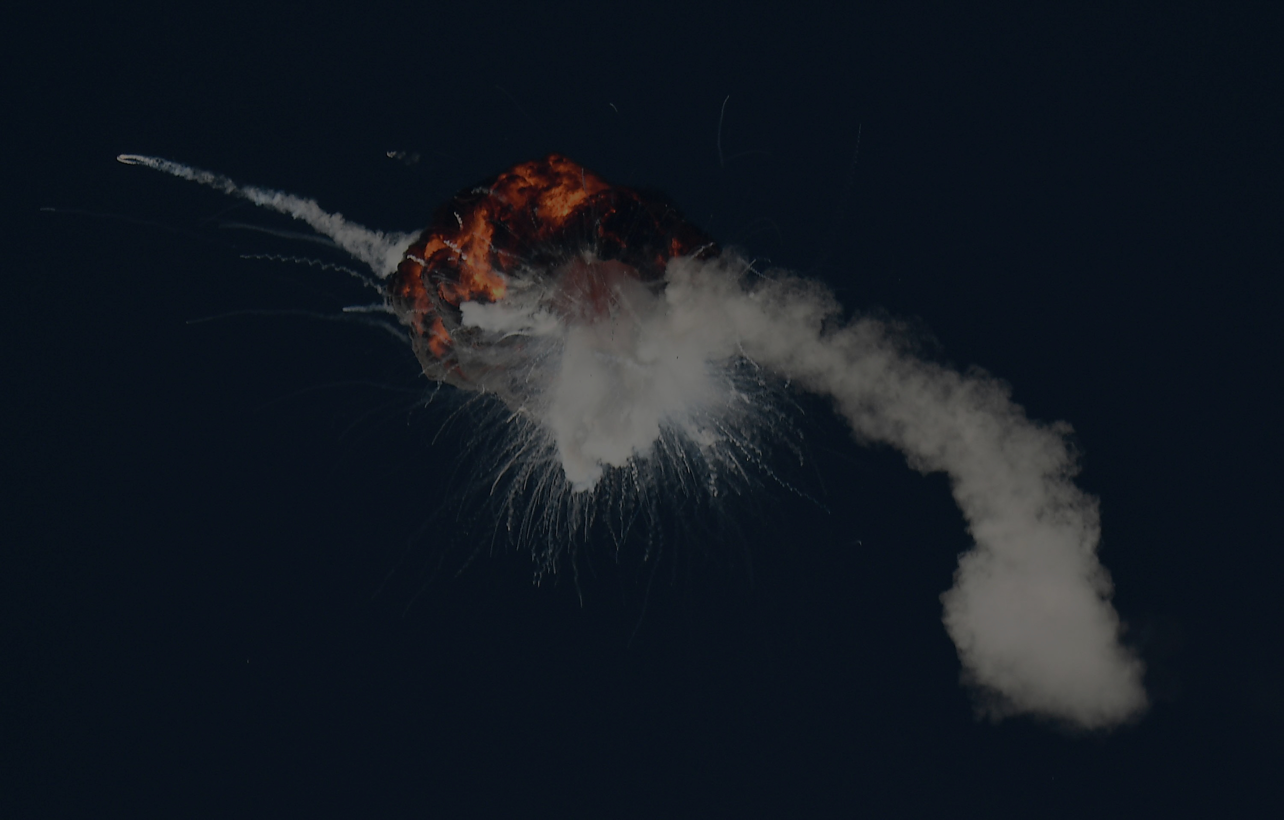
Gundam Robotics Systems
NASA Entrepreneurs Challenge 2023
“Do you really want to launch a rocket every time you need to send a payload to the moon?”
-Correo Hofstad cory.hofstad@seattlecolleges.edu

Slide 2
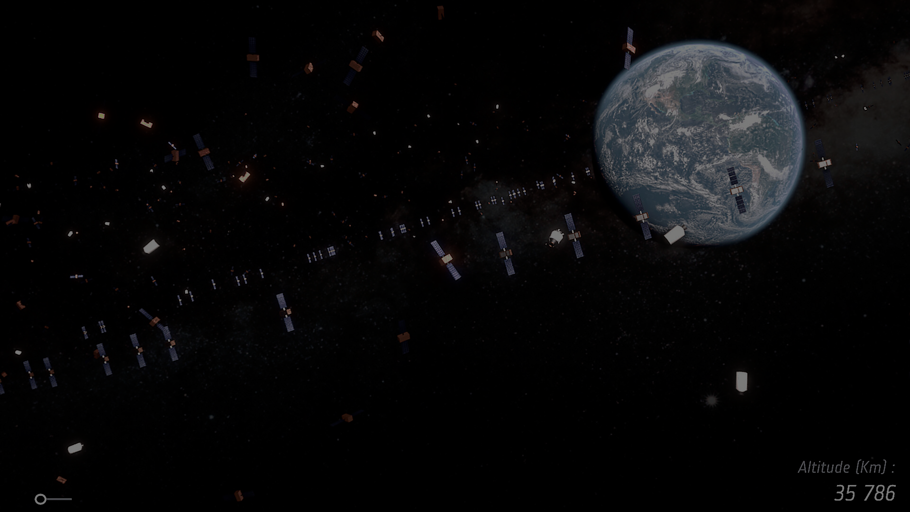
Proposed Solution & Impact (5%)
Problem Solution Fit
Physical change to crystal lattice structures does not create chemical change. Aluminum crystalizes when poured and cooled. A physical break in an aluminum circuit lead leaves behind chemical (conductive) bonds. Two double latch gates in series with aluminum leads continue to circuit after a physical break in the lead. Double latch gates in coils are able to transfer physical lattice structures within the coil radius. Each node will exist as an Aluminum coil encased in concrete or composite. Double latch gates will be looped back in the coil structures. Nodes will be broken off of the gated coil. After manufacturing, transportation, and installation nodes will exist as permanent structures.
Impact
A single space flight to install a node will allow for all future deliveries to future NASA missions from that site.
Gundam’s Buffered Payload Network reduces space traffic by creating point-to-point delivery nodes. Each node is a solid-state circuit networked by chemical bonds left over after the physical breakage of aluminum circuit leads. The law of conservation of mass delivers buffers of crystal structures (payloads) through a node to the next node, no matter how far they are physically separated. Seattle, Washington, USA is home to a functioning node at Gas Works Park which is chemically bound to nodes on Mars (East-to-West) and China’s Beijing Intl Airport (West-to-East).

Slide 3
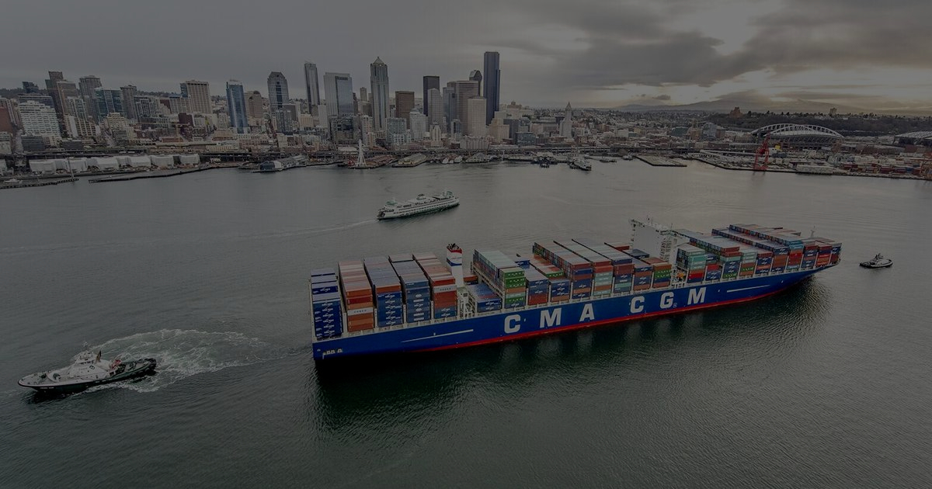
Market Potential (10%)
In an effort to maintain sterile environments on new planets, the market for Gundam equipment is limited to non-nuclear, non-hostile, allied, verified healthy persons. Gundam Robotics Systems does not have much competition for large quantum delivery gates. Space payload transportation is a multi-trillion-dollar industry. Gundam is introducing manufactured technology into the space industry which is novel and extremely valuable.
The nodes will be manufactured by Gundam-Lockheed Martin-MAN. The delivery vehicle will be made by Gundam-Boeing. Tesla is manufacturing electric trucks. MAN is manufacturing electric personnel buses. Gundam-Boeing 767-200ERs will deliver Gundam-Lockheed gates to lunar landing destinations. Off-duty Air Mobility Command crews and engineers will quickly install the gates on-site.
Space is a dangerous environment. Gundam reduces the risk of attack on our teams or interstellar wae as a result of carrying infectious or toxic materials by not allowing them. The Gundam ICP involves high-PH, security-cleared & ID-verified priority allies.
Our target market is our allies from NASA, Aerospace, space real estate, and freight cargo markets. Our market is accessible via existing road networks. Earth-based nodes will be available near rail, air, and sea ports.
Space traffic is lethal. Our nodes require one trip for delivery and allow for a lifetime of payload transportation. Gundam’s Buffered Payload Deliver Network reduces global space flights by transporting payloads and personnel through simple quantum chemical bonds within large aluminum coils. The ROI for each node exists in the absence of a need for return flights to the same site after installation. Gundam Robotics Systems has developed what science fiction may refer to as a “Stargate”.

Slide 4
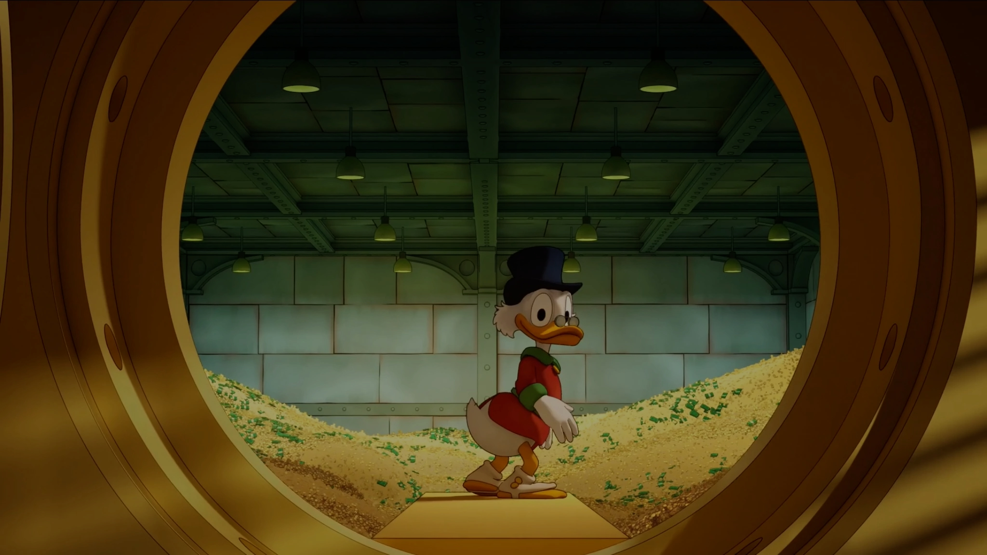
Business Model (10%)
Gundam will install quantum toll nodes with weigh stations at port-accessible locations. Verified non-nuclear, non-infectious payloads will be delivered through the nodes. Gundam will maintain contact with first responders to ensure safe node areas. Gundam will continue developing food and lodging solutions as a priority.
Our strategy is simple, the aerospace industry does not know that our technology exists and may not believe it is possible. Gundam will generate revenue like a toll stop would for a state road, with larger tools for extraterrestrial exports. Space travel is dangerous. If our tech sounds science-fiction to you, just know that some rockets people launch look science-fiction to us. Boeing space planes are not science-fiction. Boeing space planes are expensive. The United States DOD gave Gundam-Northrup Grumman the missile contract for Sentinel missiles to replace all minute man III sites. Gundam is looking to take the civilian space market as our next venture.
Gundam is backed by the Rothschild Bank. Boeing manufacturing is owned by Gundam. Gundam is profitable from salvaging, building prototypes, and developing them without selling-out or cheap manufacturing. We create future tech with our rich people’s money and sell it to people who remember us for putting them ahead of the competition.
Gundam Robotics Systems was estimated by the Smithsonian Institute to be 120 years ahead of American innovation. Gundam sells technology that does not exist otherwise. Unobtainable tech makes big money.
Our target market will not have any reasonable comparison products or technologies for at least 50 years. For example, SpaceX is still developing multiple-use rockets to deliver small payloads VS. Gundam is developing large gates which can be installed once and transport payloads forever.
A node exists at Seattle’s gasworks park which operates as a not-for-profit gate to Mars or Beijing, China. The gate is owned by Rothschild & Co. The Mars-USA-China gate manages successful payload delivery during Mars’ daytime, with the safest transport during Mars’ winter season. This working brass board exists as a template for the proposed For-Profit Gundam Buffered Payload Delivery Network.
Each gate will have a manufacturing, transportation, installation, maintenance, and use cost. Our business model is to make our technology cheaper than launching multiple rocket payloads year after year.

Slide 5
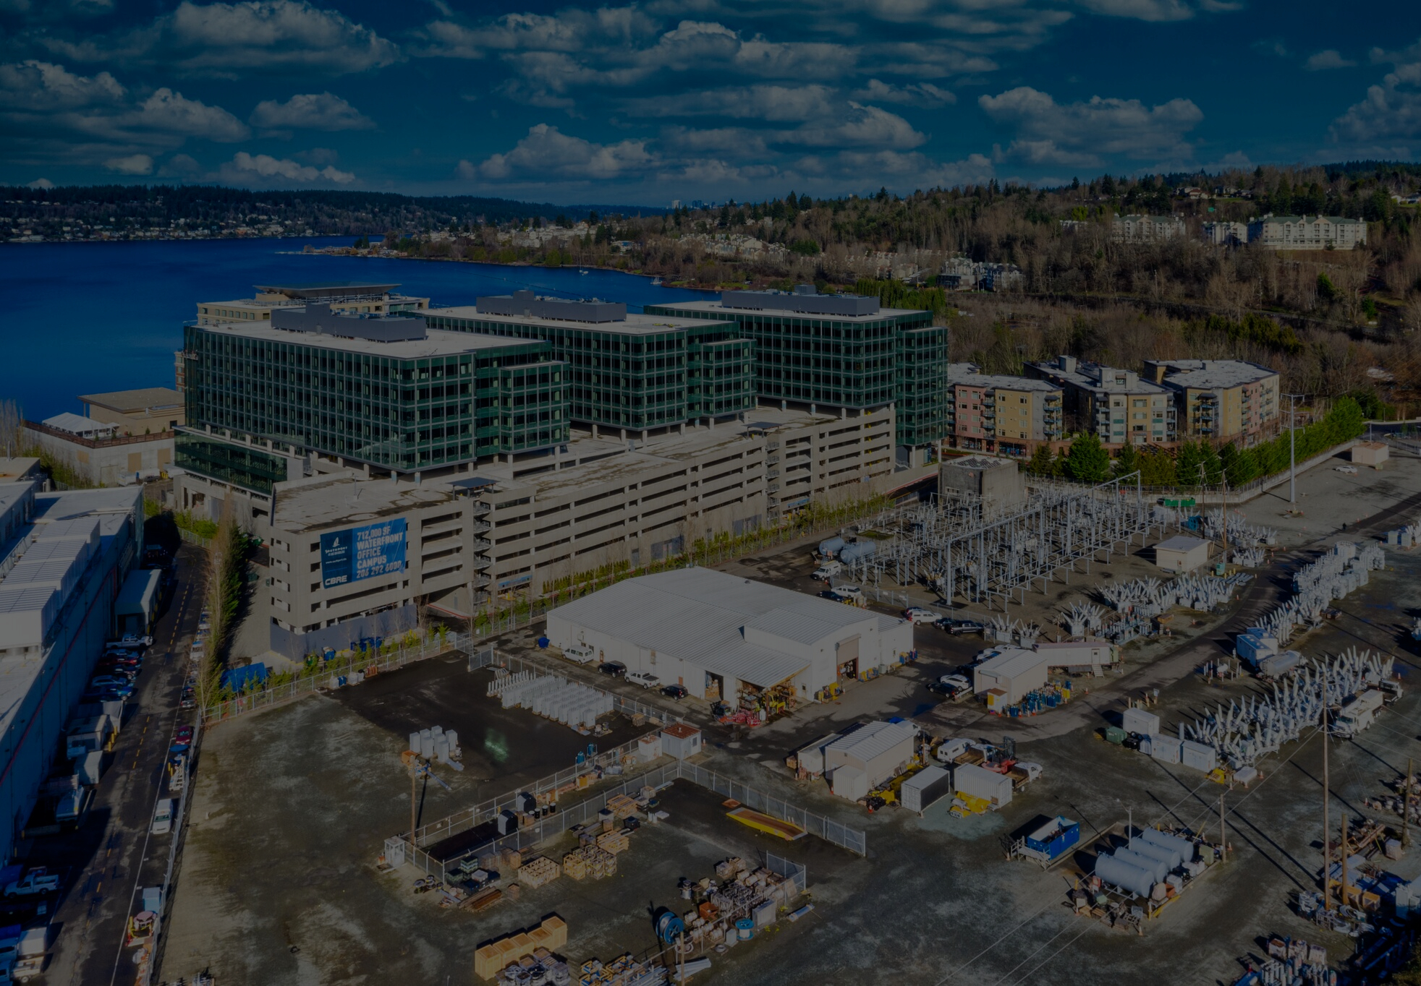
Team (10%)
Gundam is an all-military organization with a close alliance with NASA. Gundam introduced the Aqualite US air purifier technology to NASA which greatly improved the air quality on the International Space Station. Jacob Rothschild managed the construction of the nodes as seen at Seattle, WA, USA’s Gasworks Park. Cory Hofstad managed the submission and usage planning for the Nasa Entrepeneurs 2023 challenge. Gundam, Boeing, Lockheed, MAN, & Huntington Ingalls will hire soldiers, and astronauts to work together via open-source methods to find and resolve problems.
The Mars-USA-China gate has been successful for multiple decades. Mars is dangerous. The gate has to be secured by those willing to risk their lives for logistics.
Gundam is motivated by determinance for self-reliability. Our family and fans have made motivational cartoons for our pilots. SERE training is motivation as we survive by any means necessary even if it means going to dangerous planets with heavy payloads.
Gundam Robotics Systems builds American helicopters, submarines, boats, spaceships, and robots. Jacob Rothschild as Gundam’s senior commander has been building-out and coming back from successful deployments with the US military for 80+ years. Correo Hofstad executed a successful rescue of thousands of persons from Afghanistan in 2021 which provides an experience that could be used during a lunar emergency.
Contributors from SpaceX and Huntington Ingalls deliver civilian aerospace and military space force experience.

Slide 6
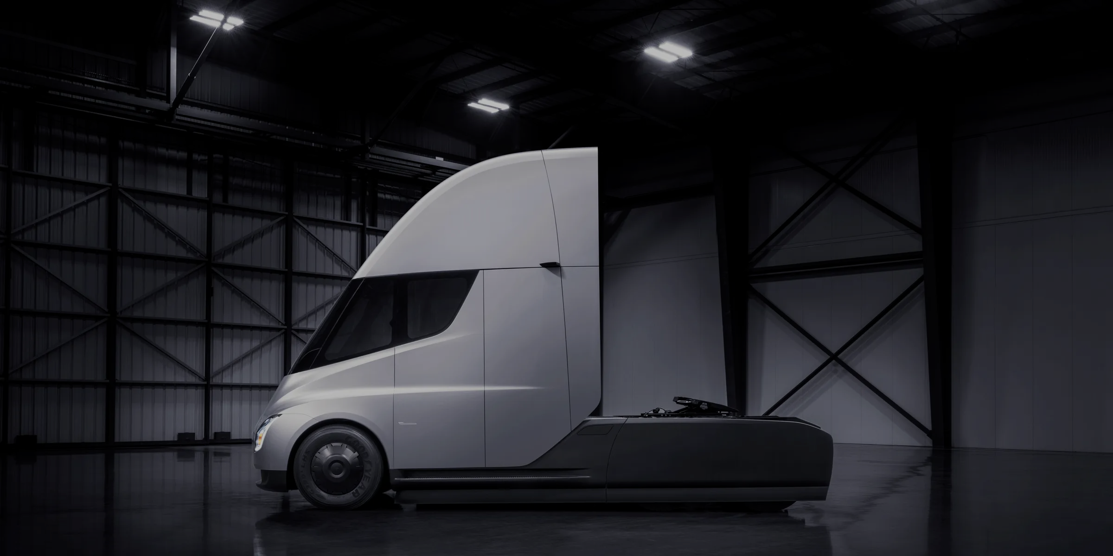
Traction (5%)
The Mars-USA-China Buffered Payload Network Node at Gasworks Park is accessible to passport-carrying allies during Mars daylight hours, preferably during Mars’ Winter. Travel data shows that previous Mars lander missions have caused nuclear outbreaks which our travelers encounter. Mars is dangerous. Space security is expensive. The current gate was built for development usage. Gundam is improving security on Mars as we begin profitable ventures. Misuse of the coils can cause loss of payload. Misuse includes exiting the coil through the side instead of the nodes at either end. Future generations of coil nodes will feature radius insulation to prevent material from exiting or entering through the side of the coil.
Lodging and hospitalities are important to our business model. Hyatt at Southport is a prime example of our service on Earth. Once our Lunar nodes are installed, Gundam will provide priority services to astronauts. Gundam has partnered with hundreds of corporations. Our open-source development to direct manufacturing process builds proven war machines. We are looking for peacetime and growth opportunities. Gundam Robotics Systems has been contracted for over 1 Trillion in defense projects. Buffered Payload Delivery has investments for over $400 Billion between the company and the United States DOT, TSA, DOL, and DOI. Ownership of the company is not at stake for this payload transportation venture.
Entrepreneurs are spending Billions trying to shuttle passengers through space while militaries of Earth are building up space forces for interstellar war. Passengers are not getting anywhere anytime soon with satellite junk and future war clouding up Earth’s escape window.
The fact that Elon Musk was willing to jump in electronic Tesla vehicles with our “Snap Circuits” and make a test drive through the Gasworks Park node was amazing for our team. Gundam felt a real industrial response to the submission of the Buffered Payload Network to the NASA Entrepreneur 2023 competition. The United States Space Force and Huntington Ingalls are making moves to secure the project during flights and to help schedule security forces for future missions involving NASA.

